Slide 1




COMPANY PROFILE
RMC2
CONSULTANCY CORP
Your trusted partner in Health, Life and Non-Life Coverage
www.rmc2consultancycorp.com

Slide 2


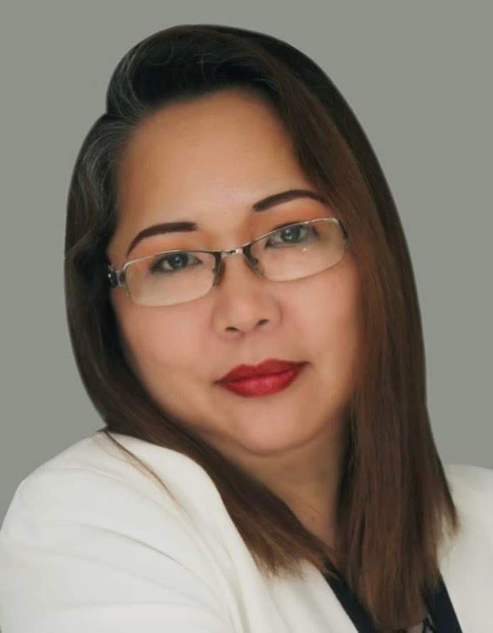
WHO WE ARE
At RMC2 Consultancy Corp, we believe that health and financial security should be accessible to everyone. Founded by Rosemarie Fernandez, who has been in the insurance industry for over 23 years, RMC2 was established with a passion for making a difference. Rosemarie has been exposed to the various needs of the market and decided to create a bridge for Filipinos who are overwhelmed by the process of insurance, making it more accessible and understandable.
We specialize in providing affordable, convenient, and reliable HMO, Life, and Non-Life Insurance solutions tailored to meet diverse needs.
Our mission is simple: to bridge the gap between people and quality healthcare by offering plans that prioritize accessibility and peace of mind. We understand that navigating insurance options can be overwhelming — that's why we take pride in guiding our clients every step of the way, ensuring clarity, compassion, and personalized service.
With a commitment to building lasting relationships, RMC2 Consultancy Corp stands as a trusted partner in safeguarding the well-being and future of individuals, families, and businesses alike.
Let us help you protect what matters most.

Slide 3

ABOUT US
At RMC2, we are dedicated to redefining the insurance experience. We specialize in providing HMO, Life, and Non-Life Insurance solutions that put people first, ensuring that protection isn’t just a privilege but a right for all. Our approach is built on three core principles: Affordability, Accessibility, and Convenience.
We understand that navigating insurance can feel overwhelming, so we’ve made it our mission to simplify the process. From personalized plans to hassle-free assistance, we’re here every step of the way, helping individuals, families, and businesses secure their future with peace of mind.
At the heart of RMC2 is a commitment to building lasting relationships. Whether it’s ensuring quick access to healthcare or offering life protection tailored to your needs, we’re more than just an insurance provider.
We are your trusted partner in safeguarding what matters most which is protecting lives and empowering futures.

Slide 4

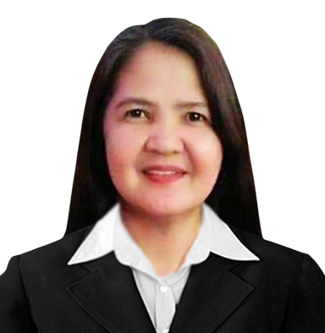
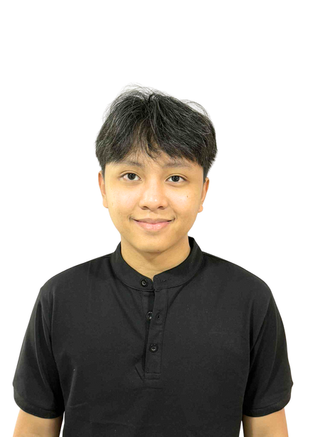

THE MANAGEMENT
ROSEMARIE FERNANDEZ
PRESIDENT & CEO
MICHELLE GUINTO
CHERRY CORTEZ
CLEMENT DOLF FERNANDEZ
CHARLES MARK UYBENGKEE
BOARD OF DIRECTOR
BOARD OF DIRECTOR
BOARD OF DIRECTOR
BOARD OF DIRECTOR

Slide 5

VISION
& MISSION
V > To break barriers where quality health and life protection is within everyone’s reach, ensuring affordability and accessibility for all.
M > To safeguard lives by delivering affordable and accessible HMO, Life, Non-Life Insurance solutions, ensuring everyone has the security and care they deserve.

Slide 6













OUR
PARTNERS
IN HEALTH

Slide 7





OUR
PARTNERS
IN LIFE

Slide 8







OUR
PARTNERS
IN NON-LIFE

Slide 9
















CLIENTS
WE SERVED
AND MORE

Slide 10


OUR GROWING NETWORK
RMC2 CONSULTANCY CORP
A growing consultancy firm for insurance solution with a strong client network, committed to promoting wellness, preventive health, and lifestyle benefits for its members.
1,200
15,300
900
SALES ADVISORS
GROUP ENROLLEES
INDIVIDUAL ACCOUNT
*DATA FROM
SEPTEMBER 2024 - NOVEMBER 2025

Slide 11

OUR
OFFICES
LUZON:
Cainta - HEAD OFFICE
Antipolo
Taytay
Bulacan
Valenzuela
Lipa
Pampanga - OPENING SOON
La Union
Baguio
Isabela
Bicol - OPENING SOON
Quezon City 1 & 2
Ilagan - OPENING SOON
VISAYAS:
Mandaue City - REGIONAL HEAD OFFICE
Cebu City - OPENING SOON
MINDANAO:
General Santos City

Slide 12








RMC2 PRODUCTS
IN PARTNERSHIP WITH AMAPHIL

Slide 13

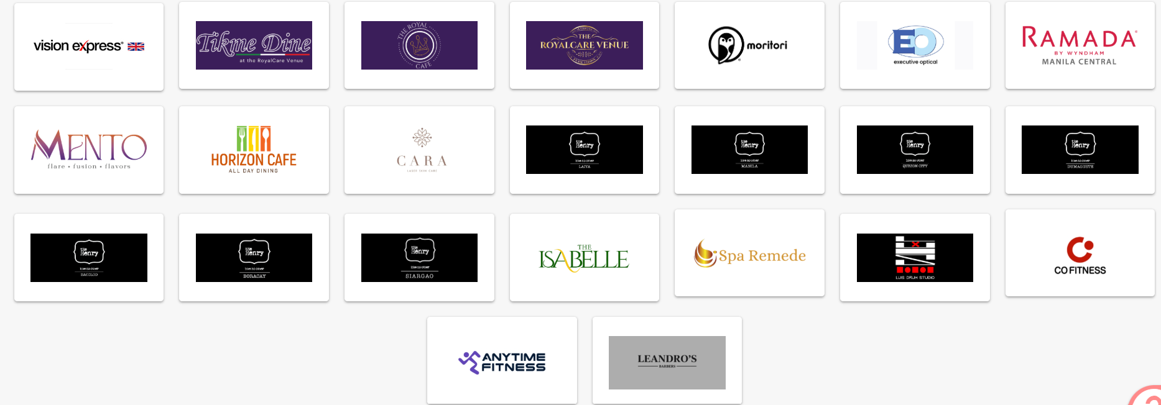
PARTNERSHIP PERKS

Slide 14



OUR NETWORK PROVIDER
Nationwide hospital and clinic accreditation thru our network provider AMAPHIL
AMAPHIL, or Advanced Medical Access Philippines, Inc., is a technology-powered Third Party Administrator (TPA) that was founded in 2016 to manage self-funded corporate health plans. It connects members to a large network of accredited hospitals, clinics, and physicians, and provides technology-driven services like online consultations via the Doctor Anywhere app. AMAPHIL's goal is to provide cost-effective, high-quality healthcare solutions for companies and their employees
www. amaphil.com.ph

Slide 15
OUR NETWORK PROVIDER
Corporate Officers
Ms. Irene Cara Gatus
Chairman
Ms. Mylene Benitez
Treasurer
Ms. Angeles Ongchangco
Corp Secretary
Ms. Mariane Odi
Board of Director
Atty. Ensign Icamen
Board of Director
www. amaphil.com.ph

Slide 16

Introducing:
ONE CARE SHIELD
RMC2 is pleased to present the Individual and Family Healthcare Program, designed to provide comprehensive and cost-efficient medical coverage for individuals and their families.

Slide 17
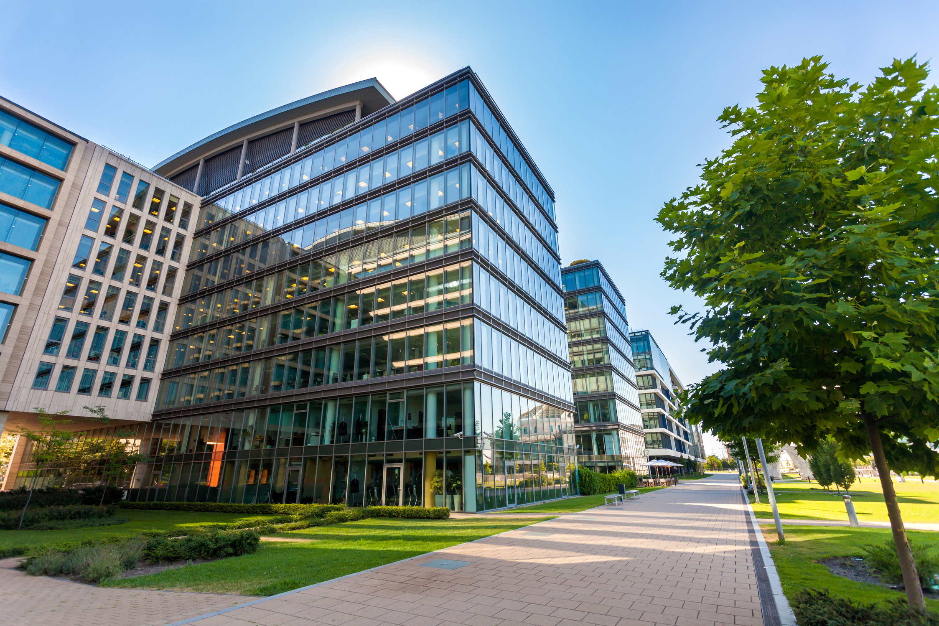
ELEGIBILITY
PRINCIPAL
INDIVIDUALS | ENTRY AGE | LAST AGE ACCEPTANCE | Renewable Upto age
 | 12 | 60 | 65

Slide 18
HEALTHCARE BENEFITS
In Patient
Out Patient
Emergency Care
APE (Annual Physical Exam)
Additional Benefits
Preventive Healthcare

Slide 19
INPATIENT BENEFITS
Room & board accommodation
Use of operating, ICU, isolation, or recovery room
Professional fees (physician, surgeon, anesthesiologist)
Nursing services, medicines, diagnostics, and supplies
Blood transfusions and fluids (recipient only)
Room upgrade (if room unavailable) – Upto 24 hours

Slide 20
OUT-PATIENT BENEFITS
Consultations and treatments that are prescribed by affiliated physicians or specialists
Pre- & post-natal consultations (excluding labs & diagnostics related to pregnancy)
Treatment for minor injuries and minor surgery (except outpatient medicines)
Dressings, casts (plaster of Paris), and sutures
Routine diagnostic and therapeutic procedures

Slide 21
OUT-PATIENT BENEFITS
Laser Eye Therapy (retinal tear, hole, detachment, glaucoma only)
- Up to ₱25,000/member/year (Excludes vision correction)
Electrocauterization of skin lesions
- Up to ₱2,500/member/year (Excludes genital warts )
Sclerotherapy for varicose veins
- Up to ₱5,000/leg/year (Medicines excluded)
Botox (non-cosmetic)
- Up to ₱10,000/member/year (Must be medically indicated )
Allergy testing and screening
- Up to ₱2,500 (Excluding the cost of allergens )
Speech therapy for stroke patients
- Up to ₱10,000/member/year (Sessions included in the limit )
Tuberculin test - Up to ₱600
Cataract surgery (excluding lens cost) - Up to ₱30,000/eye/year
Visual acuity - As charged, subject to MBL

Slide 22
DIAGNOSTIC PROCEDURES
(Whether In-Patient or Out-Patient)
Standard diagnostics and imaging (X-ray, ECG, ultrasound, CT scans, etc.)
– Upto MBL
MRI - Up to ₱10,000/illness/year
Nuclear / Radioactive Isotope Scan
- Upto ₱35,000/member/year

Slide 23
THERAPEUTIC PROCEDURES
Dialysis (peritoneal or hemodialysis)
- Up to 10 sessions, subject to MBL
Intravenous or Oral Chemotherapy
- Up to 10 sessions, subject to MBL
Therapeutic Radiology (Cobalt, Brachytherapy, etc.)
- Up to 10 sessions, subject to MBL
Physical/Occupational Therapy (shared limit)
- Up to ₱25,000/member/year

Slide 24
LATEST MODALITIES OF TREATMENT
Angiography, Angioplasty, Gamma Knife, etc.
- Up to MBL
Laparoscopic procedures / Adrenalectomy
- Up to ₱35,000/illness/year
Lithotripsy
- Up to ₱35,000/illness/year
PET Scan
- Up to ₱20,000
Cryosurgery
- Up to ₱1,000 per area
Hemorrhoidectomy (Scalpel or Stapled)
- Up to ₱10,000
Other necessary advanced modalities
- Up to ₱10,000/procedure, subject to MBL

Slide 25
ADDITIONAL BENEFITS
Motor vehicular accidents
- Up to MBL
Unprovoked assault / domestic violence
- Up to MBL
Hepatitis B (treatment only)
- Up to MBL
Sports-related injuries (non-hazardous)
- Up to MBL
Scoliosis (necessary procedures)
- Up to MBL
Scabies / Chronic Dermatoses
- Consultations Only

Slide 26
Preventive Health Care
Vaccinations (including anti-venom for bites)
- Up to 18,000 per/member/year
Health and Education Counseling
Family Planning Counseling

Slide 27

EMERGENCY CARE
In Affiliated Hospitals: Upto MBL
Physician's services
Emergency Room Fees
Medicines used for immediate relief during treatment
Oxygen, intravenous fluids and blood products
Dressings, conventional casts (plaster of Paris) and sutures
X-ray, laboratory , and diagnostic examinations, and other medical services related to the emergency treatment of the patient.

Slide 28
EMERGENCY CARE
Emergency treatment in non-affiliated
hospitals/clinics- 80% reimbursement based
on AMAPHIL RUV (Maximum of 15,000)
Emergency treatment outside the Philippines
(Reimbursable up to 15,000)
Emergency treatment in areas without affiliated
hospitals/clinics (within a 15 km radius)
100% reimbursement based on AMAPHIL RUV
Ambulance Transfer ( Up to 2,500 per conduction)
NOTE: Subject to plan limits

Slide 29

ANNUAL PHYSICAL EXAM
Physical Examination
Complete Blood Count
Urinalysis
Fecalysis
Chest X-ray
Papsmear (female 35 y.o above)
ECG (35 y.o above)
Note: APE can be availed at accredited clinics after full payment and scheduling with RMC2 two weeks before the preferred date

Slide 30

DENTAL CARE BENEFITS
a. Free & unlimited consultation & dental examinations
Simple tooth extraction, except surgery for impaction
(unlimited/maximum of 3 teeth per day)
c. Temporary fillings (up to 3 times a year)
Twice a year oral prophylaxis (mild to moderate) which can be availed of
after active membership (premium paid)/ succeeding may be availed of
six (6) months thereafter
e. Adjustment of dentures
f. Recementation of jacket crown inlays and onlays
g. Treatment of dental related pain excluding cost of prescribed medicines
h. Emergency desensitization of hypersensitive teeth
i. Annual dental examination (within the dentist’s dental clinic only)
j. Orthodontic and aesthetic dental consultation

Slide 31

DENTAL CARE BENEFITS
Availment Procedures
Provider ( 1 World Wide Health Inc.)
General Provisions
Members may avail themselves of their dental benefits through
any accredited dentist within the 1WWH network.
Dental services not covered by your plan will be charged
directly to you and must be settled with the accredited dentist.
Procedures done by non-accredited dentists are not covered
and non-reimbursable.

Slide 32
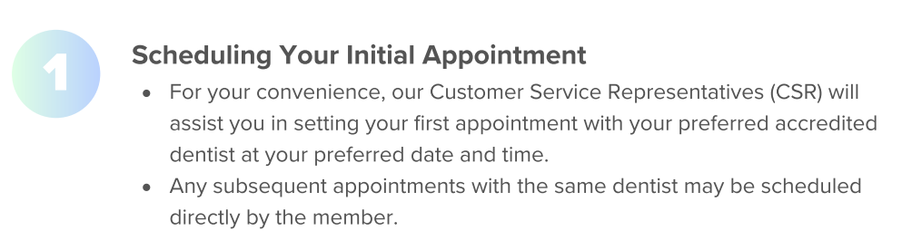
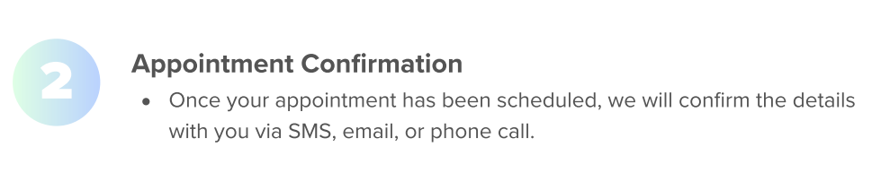
DENTAL CARE BENEFITS
Availment Procedures
Provider ( 1 World Wide Health Inc.)
Availment Steps:

Slide 33
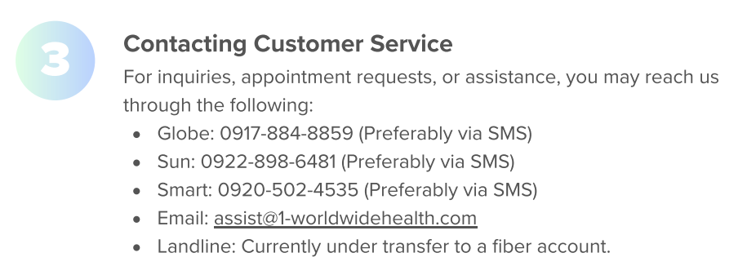
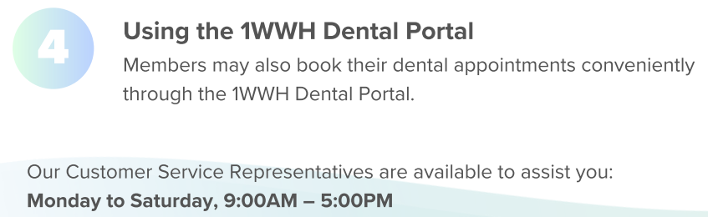
DENTAL CARE BENEFITS
Availment Procedures
Provider ( 1 World Wide Health Inc.)
Availment Steps:

Slide 34
PRE EXISTING CONDITION
Illnesses, injuries, or medical conditions that existed prior to enrollment—such as hypertension, diabetes, asthma, tumors, or arthritis etc.
The Pre-existing conditions will be covered on the 7th month of the policy, and the premium must be paid in full.

Slide 35
IMPORTANT NOTE
This plan has NO access to the Top 6 hospitals:
Asian Hospital and Medical Center
Cardinal Santos Medical Center
Makati Medical Center
The Medical City
St. Luke’s Medical Center– Quezon City
St. Luke’s Medical Center - Global City

Slide 36

GENERAL EXCLUSIONS
1. Non-Medically Necessary or Cosmetic Procedures
Plastic or reconstructive surgery for cosmetic purposes (e.g., nose lift, liposuction, facelift). Treatment for obesity, weight reduction, or body contouring. Hair loss treatments, skin whitening, or tattoo removal. Corrective eye surgery for refractive errors (LASIK, etc.).
2. Dental Services Beyond Coverage
Orthodontic braces and retainers. Cosmetic dental procedures (veneers, bleaching). Dentures and prosthetics unless specifically included in the plan.
3. Congenital, Genetic, or Developmental Conditions
Congenital or hereditary diseases (unless included in special plans). Learning disabilities, speech therapy, or developmental therapy. Genetic testing and counseling.
4. Maternity and Reproductive Services
Normal pregnancy, childbirth, and postpartum care (unless maternity coverage is explicitly added). Fertility treatment, artificial insemination, in-vitro fertilization (IVF). Contraceptives, family planning procedures, or voluntary sterilization. Circumcision, except if medically necessary (e.g., infection).

Slide 37
GENERAL EXCLUSIONS
5. Mental Health, Psychiatric, and Psychological Disorders
Psychiatric evaluation, psychotherapy, counseling, and mental health admissions (except if explicitly covered).
Drug or alcohol rehabilitation, detoxification programs.
7. Occupational or Work-Related Injuries
Work-related accidents covered by the Employees Compensation Commission (ECC) or PhilHealth. Injuries from employment hazards or while performing job duties.
8. Self-Inflicted Injuries or Illegal Acts
Suicide or attempted suicide. Self-inflicted harm. Injuries due to participation in criminal acts or resistance to lawful arrest.
9. High-Risk or Hazardous Activities
Injuries from extreme sports or activities (e.g., scuba diving, skydiving, racing, mountaineering, martial arts competitions). Accidents while under the influence of drugs or alcohol.
10. Non-Prescription or Alternative Treatments
Vitamins, supplements, herbal or alternative medicines (e.g., acupuncture, chiropractic care, traditional healers).
Experimental or investigational treatments not approved by DOH or FDA.

Slide 38
GENERAL EXCLUSIONS
11. Non-Covered Diagnostic and Administrative Costs
Executive check-ups are not listed in the APE coverage. Medical certificates, fit-to-work, travel clearance, or police report requirements. Medical supplies not medically necessary (e.g., personal comfort items, toiletries).
12. Organ Transplants and Special Treatments
Organ donor expenses. Dialysis, chemotherapy, radiation, or immunotherapy unless specifically included.
Experimental surgical or medical procedures.
13. Conditions Covered by Government or Other Insurance
Treatments or conditions already covered by PhilHealth, SSS, or ECC benefits.
14. Out-of-Network Services
Consultations or treatments done outside affiliated hospitals/clinics (except for reimbursable emergencies). Overseas medical expenses (unless global coverage is stated).

Slide 39
PREMIUM
Mode of Payment | Age Bracket | Private (₱100,000 MBL) | Semi-Private (₱75,000 MBL) | Ward (₱50,000 MBL)
Annual | 12–35 | 22,125 | 17,827 | 15,277
 | 36–45 | 23,314 | 18,792 | 16,114
 | 46–55 | 24,739 | 19,952 | 17,117
 | 56–60 | 26,282 | 21,208 | 18,203
Semi-Annual | 12–35 | 11,948 | 9,627 | 8,250
 | 36–45 | 12,590 | 10,148 | 8,702
 | 46–55 | 13,360 | 10,775 | 9,244
 | 56–60 | 14,193 | 11,453 | 9,830

Slide 40
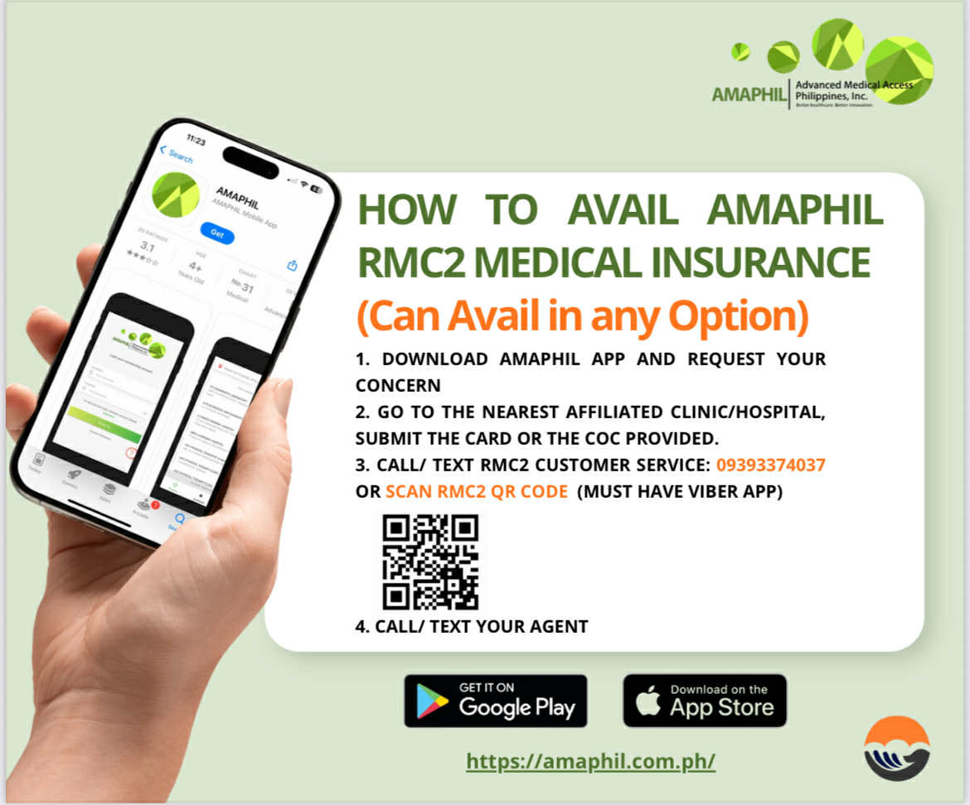

Slide 41
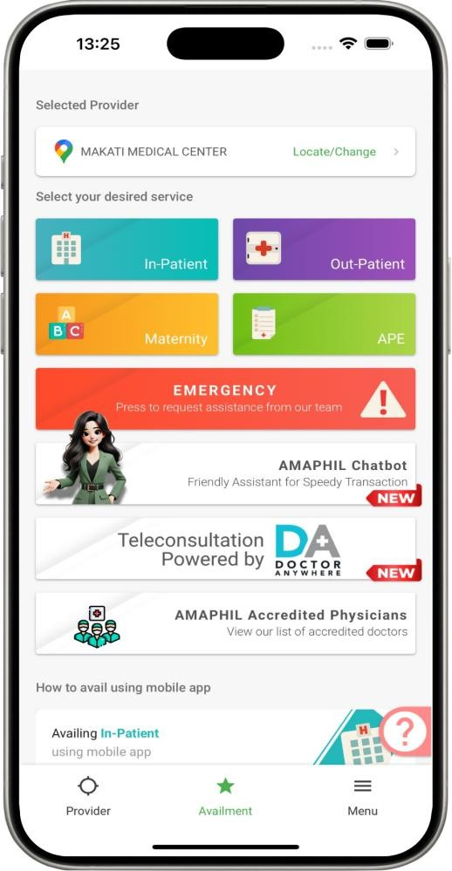
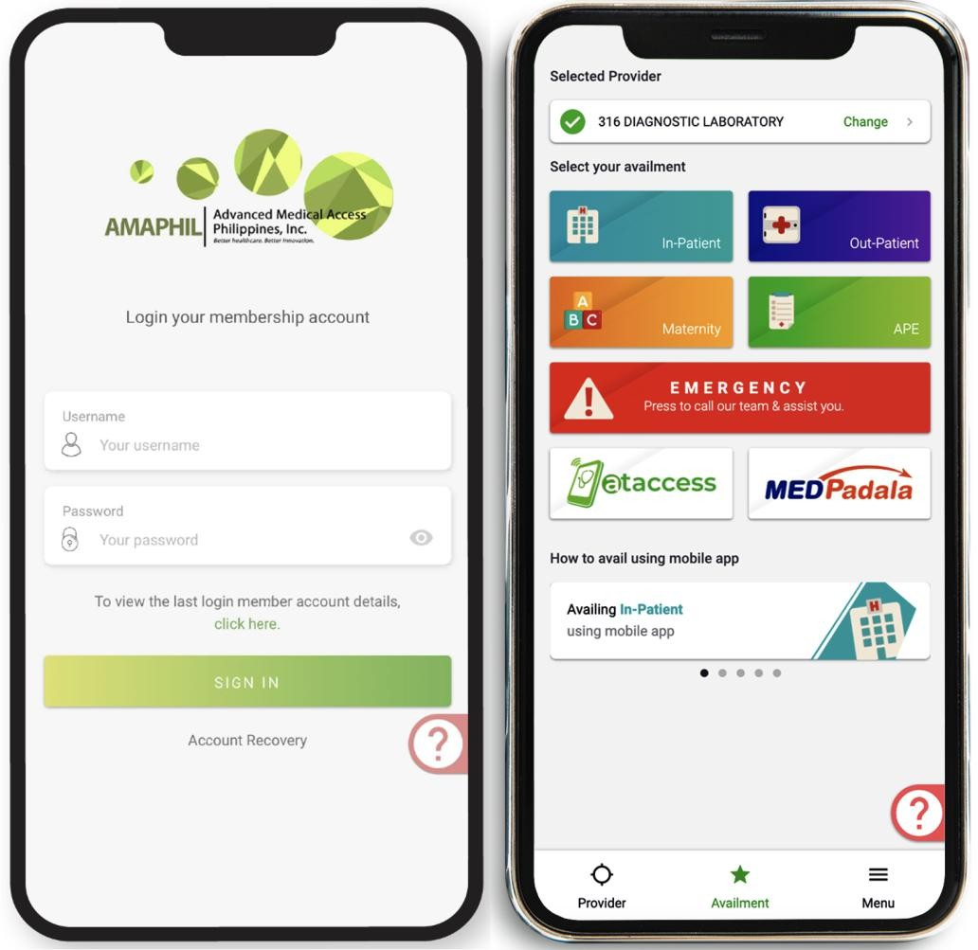
Member’s Mobile Application:
Through AMAPHIL’s mobile application, your employees may access
the following at their fingertips:
Request for LOA prior to availment;
File for reimbursement;
Review the list of benefits, exclusions and availment history;
View the latest list of providers;
See the reason for declined services;
Members can easily press Customer Service button in the Mobile
App and just wait for the AMAPHIL call.

Slide 42
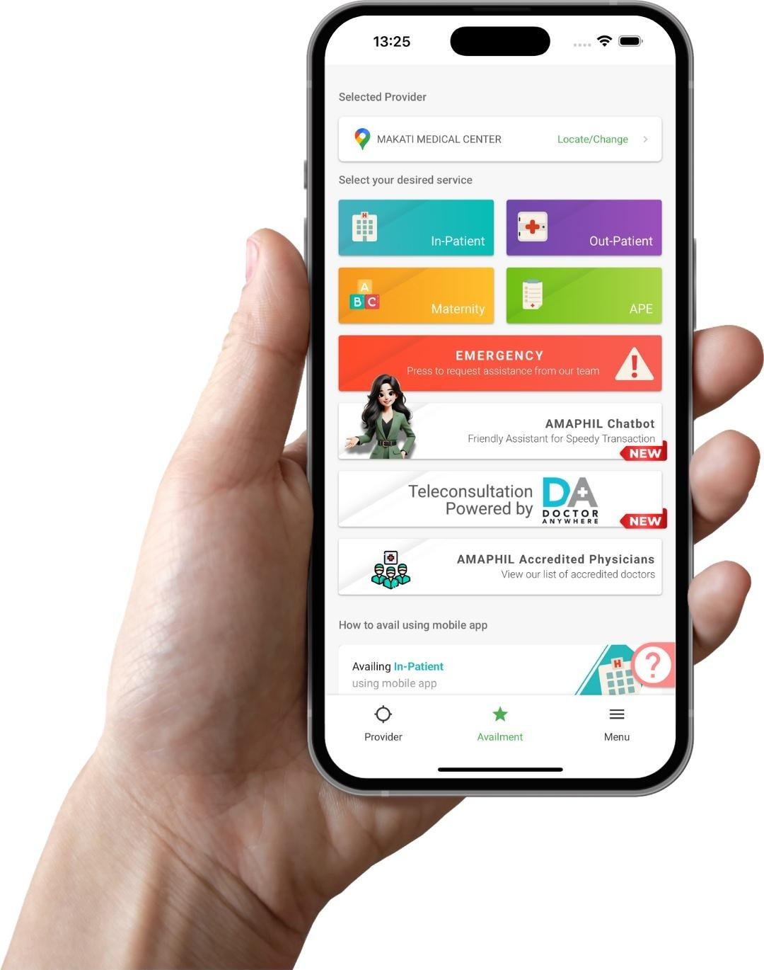
Members have immediate access to over 1,700 hospitals and clinics, and more than 51,000 doctors nationwide. Hence, there is no need to go through a tedious and expensive process of hospital and clinic affiliation.
Reduced patient wait times by using the AMAPHIL Mobile Application.

Slide 43

No Internet or Smartphone?
AMAPHIL Physical Card

Slide 44


Slide 45


THANK YOU!

